Slide 1

Apache SkyWalking

Slide 2
Application Performance Management
Real-time monitoring of enterprise systems for a systematic solution to efficiently manage faults and application performance.
Benefits:
Improvement is the reliability and quality of enterprise applications.
Customer get better services, hence improved customer experience.

Slide 3
O&M Monitoring in Umang
Tools currently used for Monitoring by O&M team in Umang:
Nagios XI for Infrastructure monitoring.
Manual testing by O&M team
Application Status Response tool to check the API status on periodic basis (currently used by QA team) can be explored further for use by O&M team

Slide 4
Apache Skywalking
SkyWalking is an open source APM system, including monitoring, tracing, diagnosing capabilities for distributed system in Cloud Native architecture.
Features
Service, service instance, endpoint metrics analysis
Root cause analysis
Service topology map analysis
Service, service instance and endpoint dependency analysis
Slow services and endpoints detection
Distributed tracing and context propagation
Database access metric. Detect slow database access statements(including SQL statements).
Alarms

Slide 5
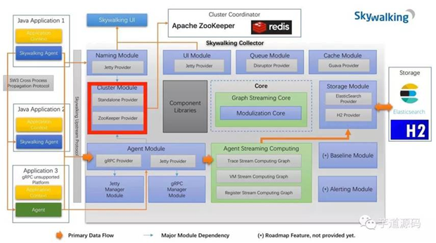
Architecture
The Architecture of SkyWalking is comprised of following components.
Probe - Agents collect data and reformat them in SkyWalking requirements
Platform Backend - for aggregation, analysis and driving process flow from probe to UI
Storage – Open Storage supports ElasticSearch, H2 or MySQL cluster
UI – Powerful and enriched visualization

Slide 6
Capabilities
Apache Skywalking Capabilities Mapping
Simple and Use friendly UI | Enriched UI to assist desk agent to isolate the problem and take prompt action.
Topology view | Topology visualization of application environment is available
Dash boarding | View response time, slow endpoints, service throughput and calls heat map in a single view.
Alarms View | Centralized alarms view configured for SLA breach alerts and errors on endpoints, service and service instances
Slow Response and Error | Capability within the tool to identify slow application response and errors
Historic and On-demand data | Historic report generation capabilities (eg. Top Slow departments in last 1 month, Service throughput, heatmap etc.
Root cause analysis capabilities | Capability to identify the possible root cause from code, class, API request and response
Security Compliance | User Login available , can only be accessed within on internal network and secured communication between collector and agents over ports 11800 & 12800
Minimal Overhead on server | Very less overhead on the application server
Easier learning curve | For NOC/Helpdesk agent to develop competency around the tool

Slide 7
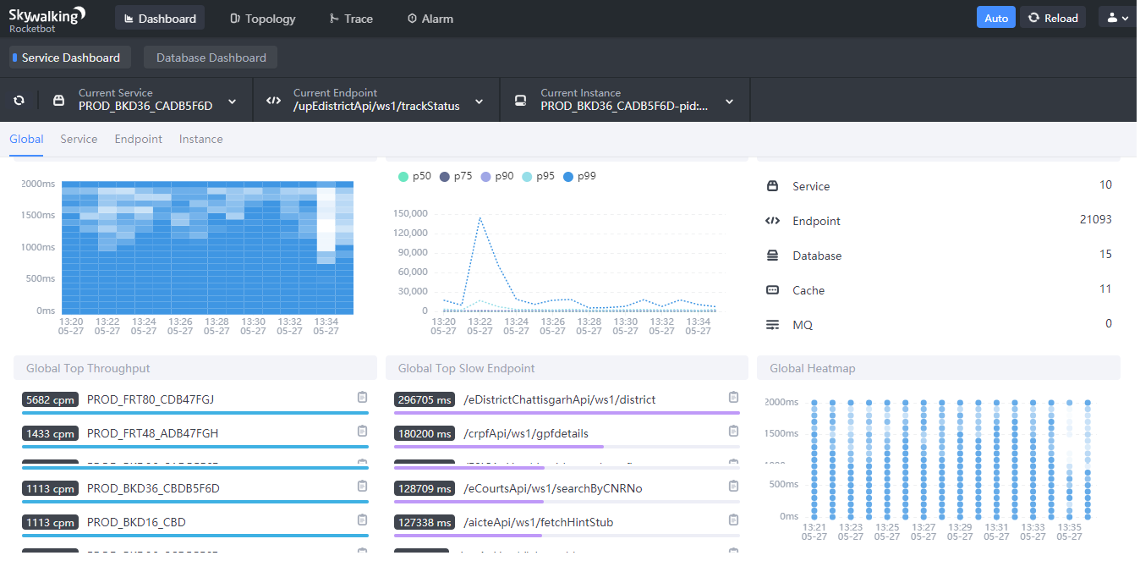
Dashboard View

Slide 8
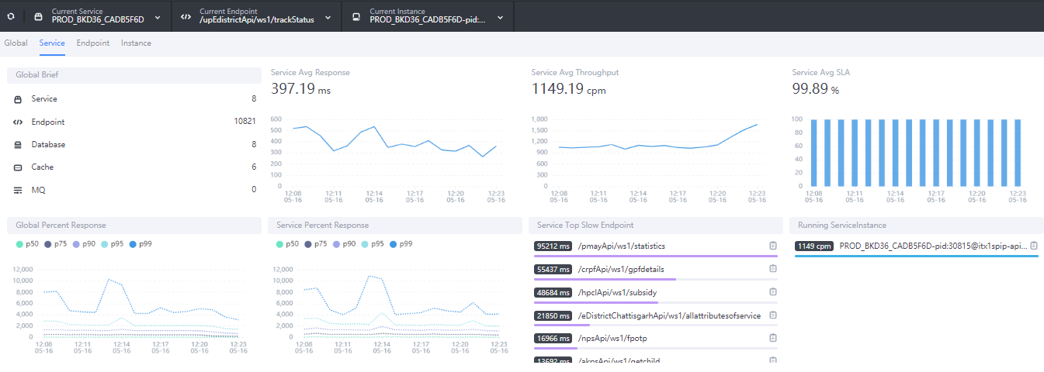
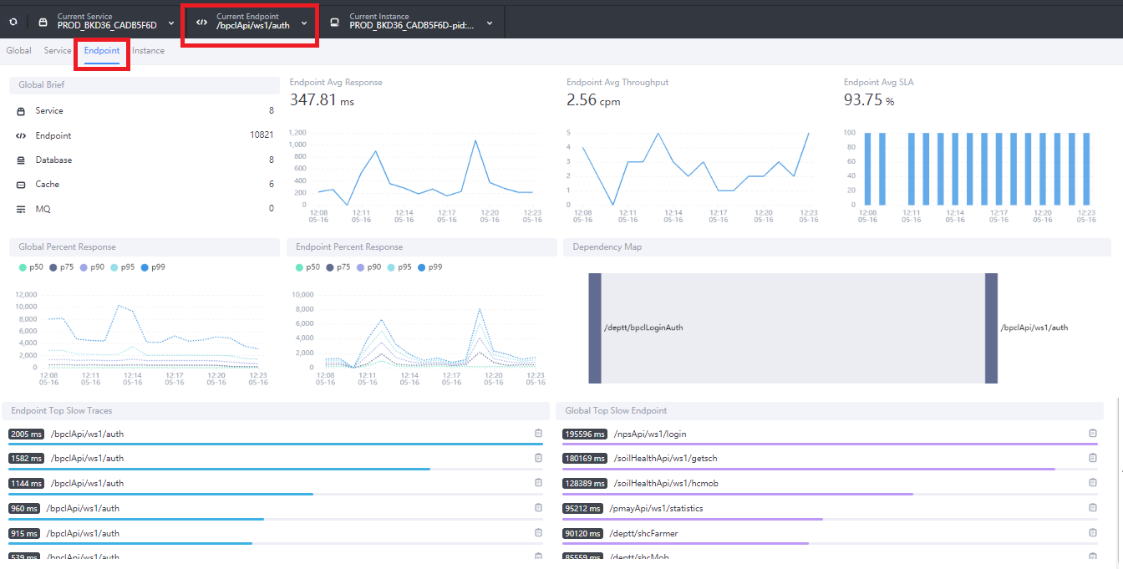
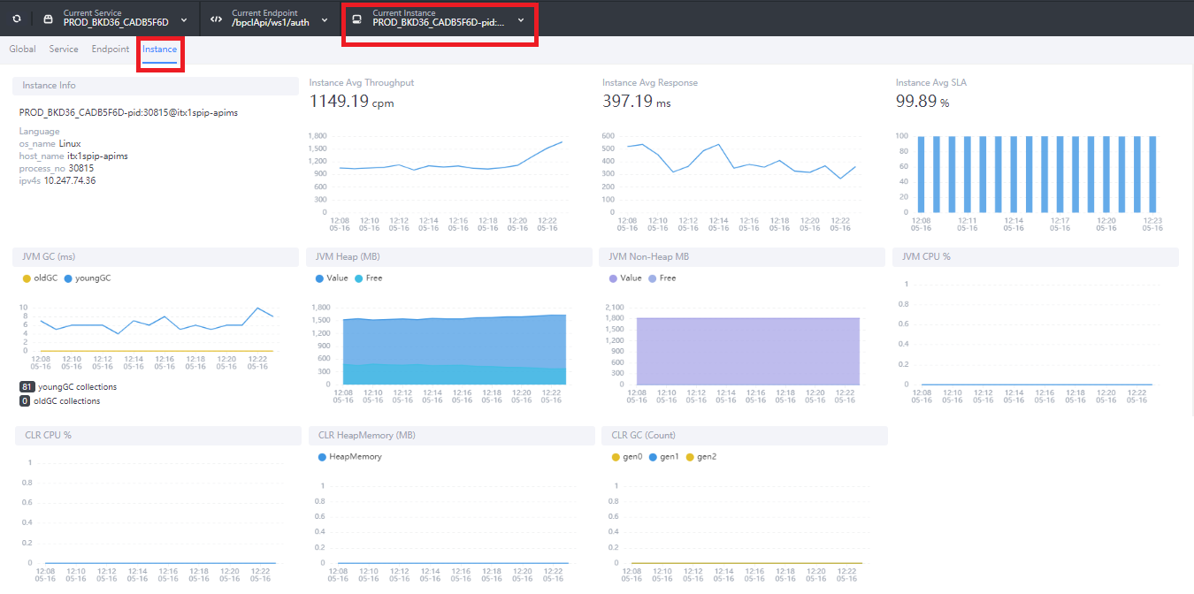
Other Dashboard Views
Dashboard – Service View
Dashboard – Endpoint View.
Dashboard – Instance View.

Slide 9
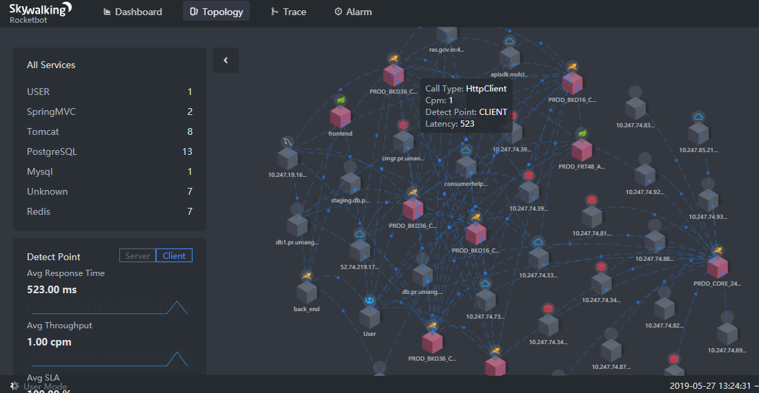
Topology Views

Slide 10
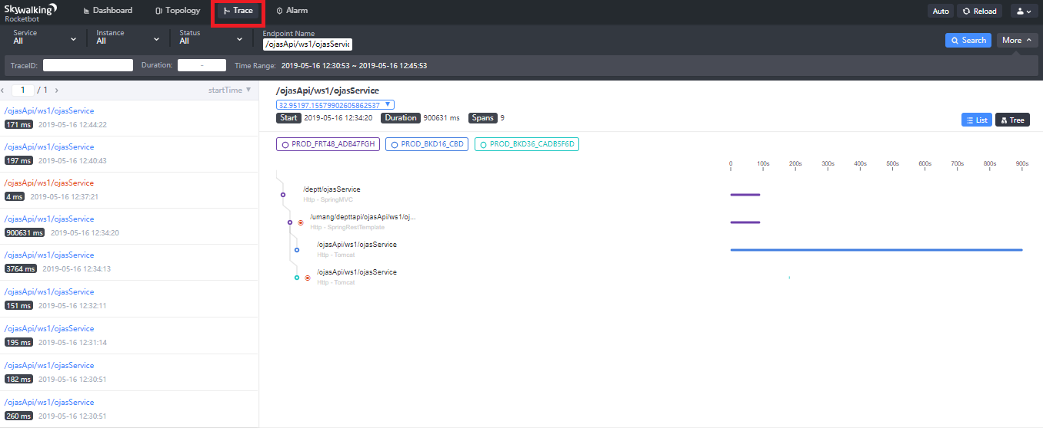
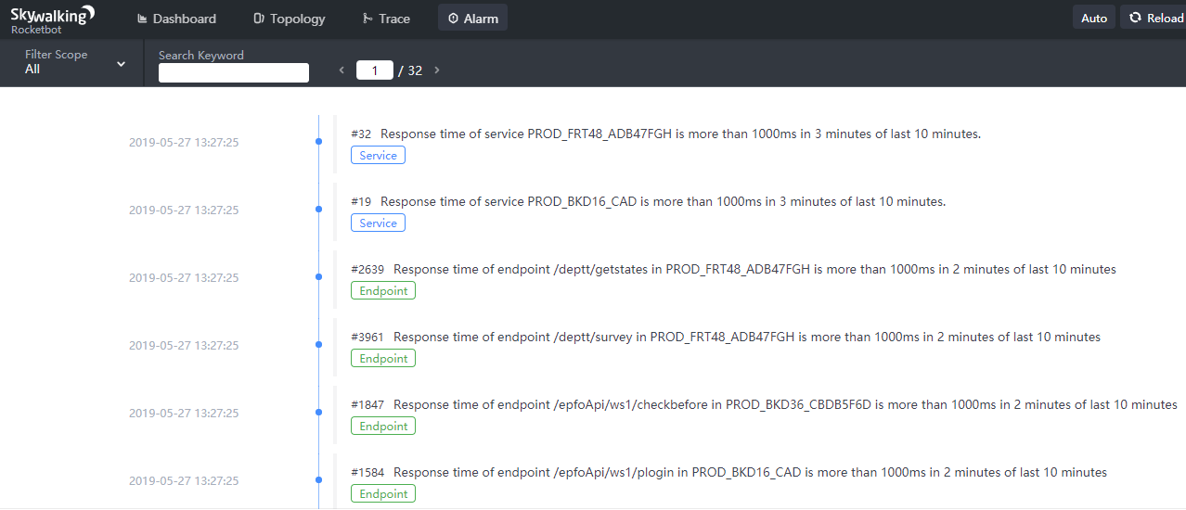
Traces and Alarms View
Trace View
Alarms View

Slide 11
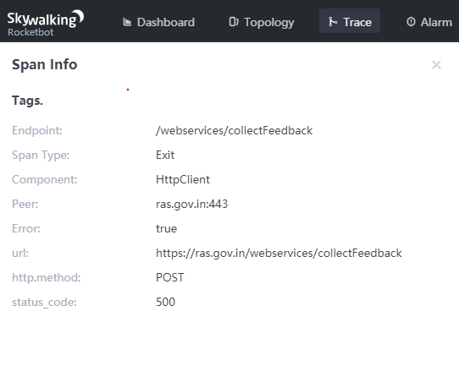
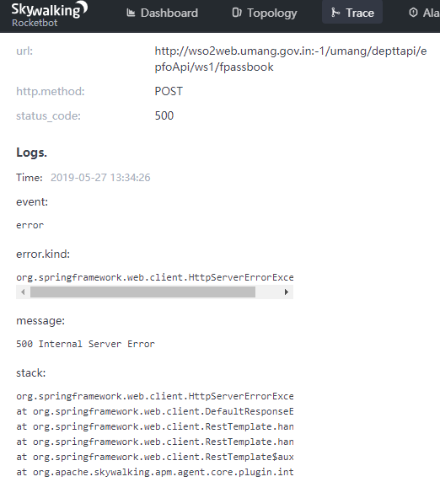
Traces and Alarms View
Span Information
Error Logs

Slide 12
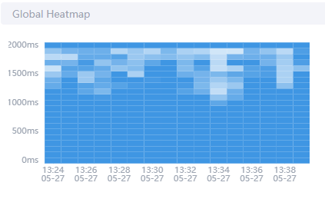
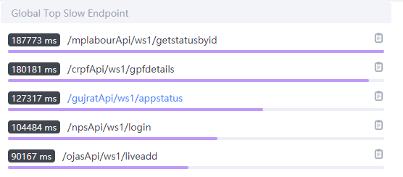
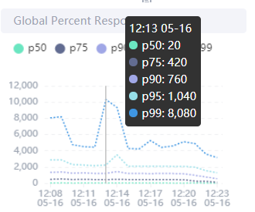
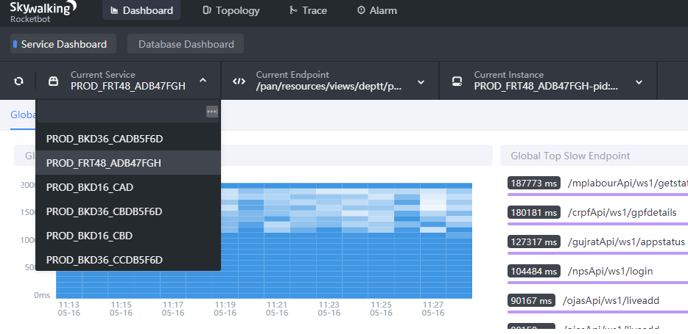
Use Cases for SkyWalking in Umang
1. End-user Experience Monitoring – Ensure enhanced end-user experience and consistently high service levels that meet business objectives by monitoring all end-user transactions. Proactively Monitor the Application response using Calls Heat map and Response time charts before customer complains of slowness.
2.Monitor individual application requests, trace call path, response summary and load

Slide 13


Use Cases for SkyWalking in Umang
3. Application Behavior Analytics – Discover anomalous application behavior and proactively alert IT operators of potential problems that could disrupt performance. Configure thresholds breach alarms
.

Slide 14
Use Cases for SkyWalking in Umang
4. Smart triage – Reduce downtime and optimize the performance of support teams by proactively identifying, diagnosing and resolving performance problems before they impact end users.

Slide 15
Use Cases for SkyWalking in Umang
5. Rapid root-cause diagnosis – Improve IT productivity and control costs by quickly and accurately diagnosing problems occurring deep within the application and infrastructure.

Slide 16
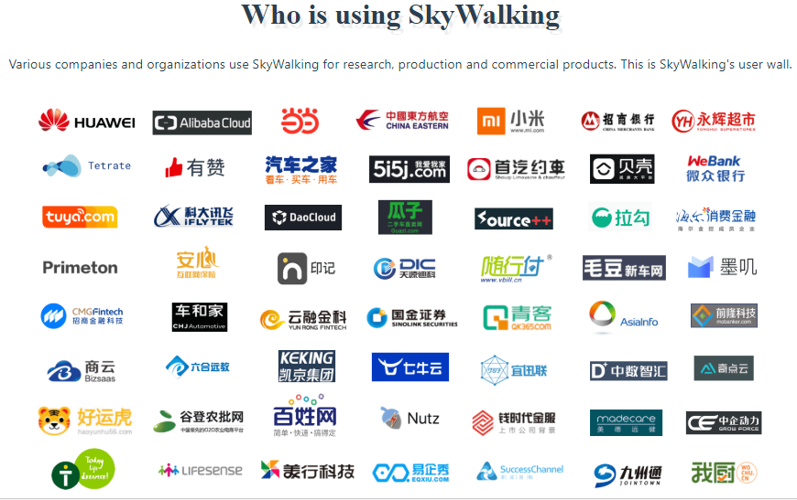
Organizations using Apache SkyWalking

Slide 17
More Information
Webpage: https://skywalking.apache.org
Documentation: https://github.com/apache/skywalking/tree/master/docs
Blog: https://skywalking.apache.org/blog/
Guides: https://github.com/apache/skywalking/tree/master/docs/en/guides
Performance Benchmarking: https://github.com/SkyAPMTest/Agent-Benchmarks

Slide 18
Thank You.

